Slide 1
CPU Scheduling
In the uniprogrammming systems like MS DOS, when a process waits for any I/O operation to be done, the CPU remains idle. This is an overhead since it wastes the time and causes the problem of starvation.
However, in Multiprogramming systems, the CPU doesn't remain idle during the waiting time of the Process and it starts executing other processes. Operating System has to define which process the CPU will be given.
In Multiprogramming systems, the Operating system schedules the processes on the CPU to have the maximum utilization of it and this procedure is called CPU scheduling. The Operating System uses various scheduling algorithm to schedule the processes.

Slide 2
CPU Scheduling…
It is a process of determining which process will own CPU for execution while the execution of another process is on hold(in waiting state) due to unavailability of any resource like I/O etc.,.
The aim of CPU scheduling is to make the system efficient, fast and fair.
Whenever the CPU becomes idle, the operating system must select one of the processes in the ready queue to be executed.
The selection process is carried out by the short-term scheduler (or CPU scheduler).
The scheduler selects one from set of processes in memory that are ready to execute, and allocates the CPU to one of them.

Slide 3
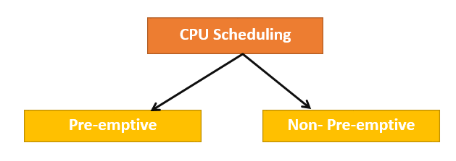
Types
Two kinds of Scheduling methods
Preemptive Scheduling
Non- Pre-emptive Scheduling
The basic difference between preemptive and non-preemptive scheduling is that: In preemptive scheduling, the CPU is allocated to the processes for the limited time.
In Non-preemptive scheduling, the CPU is allocated to the process till it terminates or switches to waiting state.

Slide 4
Preemptive Scheduling
The tasks are usually assigned with priorities.
At times it is necessary to run a certain task that has a higher priority before another task although it is running.
Therefore, the running task is interrupted for some time and resumed later when the priority task has finished its execution.
Non- Preemptive Scheduling
Once the CPU has been allocated to a process, the process keeps the CPU until it releases the CPU either by terminating or aborting.

Slide 5
Scheduling is Preemptive or Non-Preemptive?
To determine if scheduling is preemptive or non-preemptive, consider these four parameters:
A process switches from the running to the waiting state.
Specific process switches from the running state to the ready state.
Specific process switches from the waiting state to the ready state.
Process finished its execution and terminated.
Only conditions 1 and 4 apply, the scheduling is called non- preemptive.
All other scheduling are preemptive.

Slide 6
Scheduling Criteria
There are many different criteria's to check when considering the "best" scheduling algorithm, they are:
CPU Utilization: To make out the best use of CPU and not to waste any CPU cycle, CPU would be working most of the time(Ideally 100% of the time).
Throughput: It is the total number of processes completed per unit time or rather say total amount of work done in a unit of time.
Load Average: It is the average number of processes residing in the ready queue waiting for their turn to get into the CPU.
Another metric is fairness.
Performance and fairness are often at odds in scheduling; a scheduler, for example, may optimize performance but at the cost of preventing a few jobs from running, thus decreasing fairness. This conundrum shows us that life isn’t always perfect.

Slide 7
Waiting Time (WT)
The amount of time a process has been waiting in the ready queue to acquire get control on the CPU.
Turnaround Time (TAT)
It is the amount of time taken to execute a particular process, i.e. The interval from time of submission of the process to the time of completion of the process(Wall clock time). The time at which the job completes minus the time at which the job arrived in the system
Response Time(RT)
Amount of time it takes from when a request was submitted until the first response is produced. The difference between the arrival time and the time at which the process first gets the CPU is called Response Time.

Slide 8
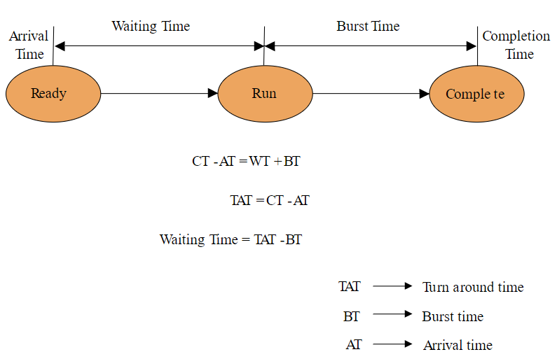

Slide 9
CPU Scheduling algorithms
The process scheduling is the activity of the process manager that handles the removal of the running process from the CPU and the selection of another process on the basis of a particular strategy.
Workload assumptions:
Each job runs for the same amount of time.
All jobs arrive at the same time.
All jobs only use the CPU (i.e., they perform no I/O).
The run-time of each job is known.
Scheduling metric:
A metric is just something that we use to measure something, and there are a number of different metrics that make sense in scheduling.

Slide 10
Scheduling algorithms
The Purpose of a Scheduling algorithms
Maximum CPU utilization
Fare allocation of CPU
Maximum throughput
Minimum turnaround time
Minimum waiting time
Minimum response time

Slide 11
Scheduling Algorithms
To decide which process to execute first and which process to execute last to achieve maximum CPU utilization, we have some algorithms, they are:
First Come First Serve(FCFS) Scheduling
Shortest-Job-First(SJF) Scheduling
Priority Scheduling
Round Robin(RR) Scheduling
Multilevel Queue Scheduling
Multilevel Feedback Queue Scheduling

Slide 12
Multilevel Queue (MLQ) CPU Scheduling
Many processes in the ready queue can be divided into different classes where each class has its own scheduling needs.
For example, a common division is a foreground (interactive) process and a background (batch) process. These two classes have different scheduling needs. For this kind of situation Multilevel Queue Scheduling is used.
Ready Queue is divided into separate queues for each class of processes. For example, let us take three different types of processes System processes, Interactive processes, and Batch Processes. All three processes have their own queue.
According to the priority of process, processes are placed in the different queues.
Generally high priority process are placed in the top level queue.
Only after completion of processes from top level queue, lower level queued processes are scheduled.

Slide 13
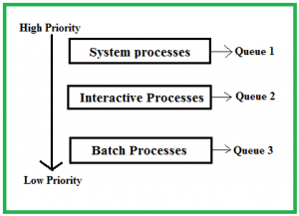
Multilevel Queue (MLQ) CPU Scheduling(Cont..)
All three different type of processes has their own queue. Each queue has its own Scheduling algorithm.
For example, queue 1 and queue 2 uses Round Robin while queue 3 can use FCFS to schedule their processes.

Slide 14
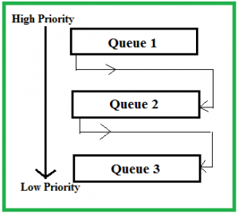
Multi level Feedback Queue (MLFQ) Scheduling
It allows the process to move in between queues.
The idea is to separate processes according to the characteristics of their CPU bursts.
If a process uses too much CPU time, it is moved to a lower-priority queue.
A Scheduler that learns from the past to predict the future.
Objective:
Optimize turnaround time → Run shorter jobs first
Minimize response time without a priori knowledge of job length.

Slide 15
MLFQ: Basic Rules
MLFQ has a number of distinct queues.
Each queue is assigned a different priority level.
At any given time, a job that is ready to run is on a single queue.
A job on a higher queue is chosen to run.
Use round-robin scheduling among jobs in the same queue

Slide 16
MLFQ: Basic Rules (Cont.)
Rather than giving a fixed priority to each job, MLFQ varies the priority of a job based on its observed behavior.
Example:
A job repeatedly relinquishes/give up the CPU while waiting IOs → Keep its priority high
A job uses the CPU intensively for long periods of time → Reduce its priority.
Rule 1: If Priority(A) > Priority(B), A runs (B doesn’t).
Rule 2: If Priority(A) = Priority(B), A & B run in RR.

Slide 17
MLFQ Example
[High Priority]
Q8
Q7
Q6
Q5
Q4
Q3
Q2
Q1
A
B
C
[Low Priority]
D

Slide 18
In the figure, two jobs (A and B) are at the highest priority level, while job C is in the middle and Job D is at the lowest priority.
Given our current knowledge of how MLFQ works, the scheduler would just alternate time slices between A and B because they are the highest priority jobs in the system.
poor jobs C and D would never even get to run – an outrage!
We need to understand how job priority changes over time.

Slide 19
MLFQ: How to Change Priority
MLFQ priority adjustment algorithm:
Rule 1: When a job enters the system, it is placed at the highest priority
Rule 2: If a job uses up an entire time slice while running, its priority is reduced (i.e., it moves down on queue).
Rule 3: If a job gives up the CPU before the time slice is up, it stays at the same priority level
In this manner, MLFQ approximates SJF

Slide 20
Algorithm Evaluation
Selecting an algorithm can be difficult. The first problem is defining the criteria to be used in selecting an algorithm.
Criteria are often defined in terms of CPU utilization, response time, or throughput.
To select an algorithm, criteria may include several measures, such as:
Maximizing CPU utilization under the constraint that the maximum response time is 1 second
Maximizing throughput such that turnaround time is (on average) linearly proportional to total execution time

Slide 21
Thread
A thread is a path of execution within a process.
A thread is also called a lightweight process.
A process can contain multiple threads.
Threads provide a way to improve application performance through parallelism by dividing a process into multiple threads
A thread shares with its peer threads few information like code segment, data segment and open files.
When one thread alters a code segment memory item, all other threads see that.

Slide 22
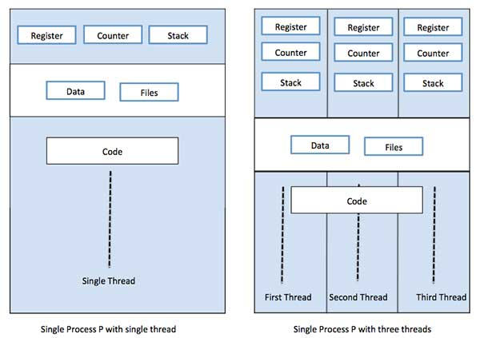

Slide 23
Advantages of threads
Threads minimize the context switching time.
Use of threads provides concurrency within a process.
Efficient communication.
It is more economical to create and context switch threads.
Threads allow utilization of multiprocessor architectures to a greater scale and efficiency.

Slide 24
Disadvantages of threads
Thread synchronization is an extra over head to the developers.
Shares the common data across the threads might cause the data inconsistency or thread sync issues
Threads blocking for resources is more common problem
Difficult in managing the code in terms of debugging or writing the code

Slide 25
Types of Thread
Threads are implemented in following two ways −
User Level Threads − User managed threads.
Kernel Level Threads − Operating System managed threads acting on kernel, an operating system core.

Slide 26
Multithreading Models
Multiple threads within the same application can run in parallel on multiple processors and a blocking system call need not block the entire process.
Multithreading models are three types
Many to many relationship.
Many to one relationship.
One to one relationship.

Slide 27
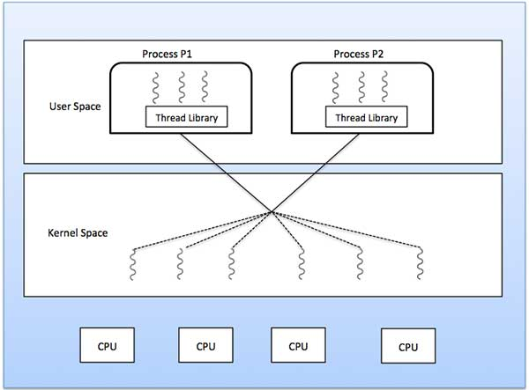
Many to Many Model
The many-to-many model multiplexes any number of user threads onto an equal or smaller number of kernel threads.
The following diagram shows the many-to-many threading model where 6 user level threads are multiplexing with 6 kernel level threads.

Slide 28
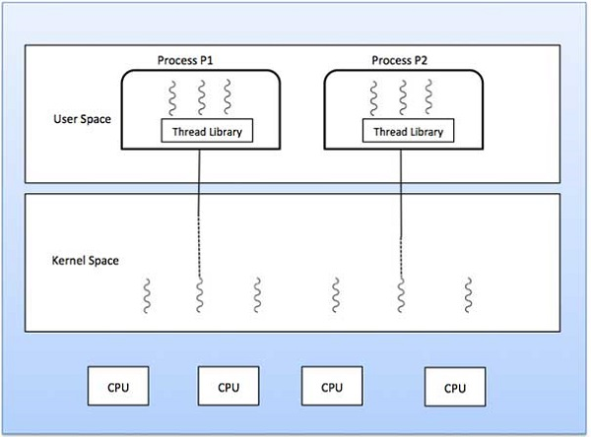
Many to One Model
Many-to-one model maps many user level threads to one Kernel-level thread.
Thread management is done in user space by the thread library.
When thread makes a blocking system call, the entire process will be blocked.
Only one thread can access the Kernel at a time, so multiple threads are unable to run in parallel on multiprocessors.

Slide 29
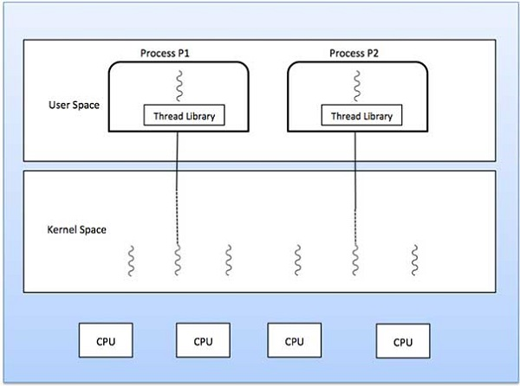
One to One Model
There is one-to-one relationship of user-level thread to the kernel-level thread.
This model provides more concurrency than the many-to-one model.
It also allows another thread to run when a thread makes a blocking system call.
It supports multiple threads to execute in parallel on microprocessors.

Slide 30
Multiple-Processor Scheduling
A multiprocessor system consists of several processors which share memory.
In the multiprocessor, there is more than one processor in the system
In the multiprocessor system all the processors operate under the single operating system.
Multiple processor scheduling is more complex as compared to single processor scheduling.
In multiple processor scheduling the processors are identical i.e. HOMOGENEOUS, in terms of their functionality, we can use any processor available to run any process in the queue.

Slide 31
Approaches
When all the scheduling decisions and I/O processing are handled by a single processor which is called the Master Server and the other processors executes only the user code. This entire scenario is called Asymmetric Multiprocessing.
Uses Symmetric Multiprocessing where each processor is self scheduling. All processes may be in a common ready queue or each processor may have its own private queue for ready processes.

Slide 32
Multi core programming
A processor that has more than one core is called Multicore Processor
These cores can individually read and execute program instructions, giving feel like computer system has several processors but in reality, they are cores and not processors.
Processor can run instructions on separate cores at same time. This increases overall speed of program execution in system.
Multicore systems support Multithreading and Parallel Computing.
Software that can run parallelly is preferred because we want to achieve parallel execution with the help of multiple cores.
Concurrent systems that we create using multicore programming have multiple tasks executing in parallel. This is known as concurrent execution.

Slide 33
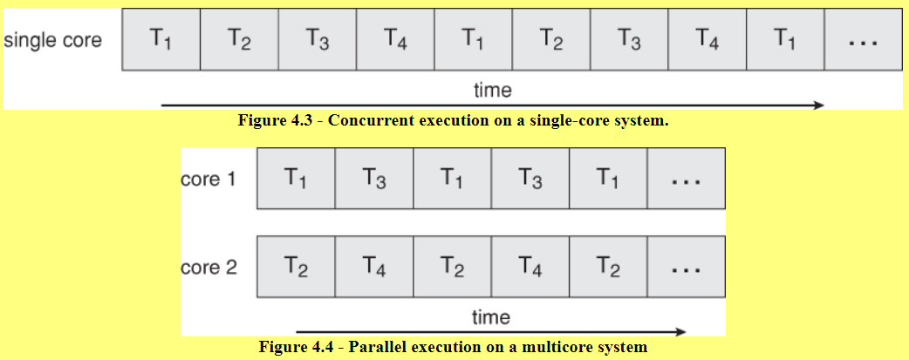
Multi core programming…
A recent trend in computer architecture is to produce chips with multiple cores, or CPUs on a single chip.
A multi-threaded application running on a traditional single-core chip would have to interleave the threads, as shown in given Figure 4.3.
On a multi-core chip, however, the threads could be spread across the available cores, allowing true parallel processing, as shown in Figure 4.4.
For operating systems, multi-core chips require new scheduling algorithms to make better use of the multiple cores available.
As multi-threading becomes more pervasive and more important ( thousands instead of tens of threads ), CPUs have been developed to support more simultaneous threads per core in hardware.

Slide 34
Multi core programming…
Programming Challenges: For application programmers, there are five areas where multi-core chips present new challenges:
Identifying tasks - Examining applications to find activities that can be performed concurrently.
Balance - Finding tasks to run concurrently that provide equal value. i.e. don't waste a thread on trivial tasks.
Data splitting - To prevent the threads from interfering with one another.
Data dependency - If one task is dependent upon the results of another, then the tasks need to be synchronized to assure access in the proper order.
Testing and debugging - Inherently more difficult in parallel processing situations, as the race conditions become much more complex and difficult to identify.

Slide 35
Multi core programming…
Types of Parallelism:
In theory there are two different ways to parallelize the workload:
Data parallelism divides the data up amongst multiple cores ( threads ), and performs the same task on each subset of the data. For example dividing a large image up into pieces and performing the same digital image processing on each piece on different cores.
Task parallelism divides the different tasks to be performed among the different cores and performs them simultaneously.
In practice no program is ever divided up solely by one or the other of these, but instead by some sort of hybrid combination.

Slide 36
Thread Libraries
A thread library provides the programmer an API for creating and managing threads. There are two primary ways of implementing a thread library.
The first approach is to provide a library entirely in user space with no kernel support. All code and data structures for the library exist in user space. This means that invoking a function in the library results in a local function call in user space and not a system call.
The second approach is to implement a kernel-level library supported directly by the OS. In this case, code and data structures for the library exist in kernel space. Invoking a function in the API for the library typically results in a system call to the kernel.

Slide 37
Three main thread libraries are in use today:
POSIX Pthreads: Pthreads, the threads extension of the POSIX standard, may be provided as either a user- or kernel-level library.
Win32: The Win32 thread library is a kernel-level library available on Windows systems.
Java: The Java thread API allows thread creation and management directly in Java programs. However, because in most instances the JVM is running on top of a host OS, the Java thread API is typically implemented using a thread library available on the host system.

